Slide 1

Investigation of MHD Mode Structure in Shaped HBT-EP Plasmas
Patrick Byrne
April 13th, 2015

Slide 2
Outline
Introduction
Motivation for Shaped Plasma Research on HBT-EP
HBT-EP Baseline and New Capabilities
Analysis Procedures
New Challenges with Shaped Plasmas
Plasma/Sensor coupling
Positional Instability
Proposed Research Plan
Observe Structure and Dynamics of RWM in Shaped Plasmas
Natural Structure/Growth Rates
RMP Response
Initial Results
Summary

Slide 3
Outline
Introduction
Motivation for Shaped Plasma Research on HBT-EP
HBT-EP Baseline and New Capabilities
Analysis Procedures
New Challenges with Shaped Plasmas
Plasma/Sensor coupling
Positional Instability
Proposed Research Plan
Observe Structure and Dynamics of RWM in Shaped Plasmas
Natural Structure/Growth Rates
RMP Response
Initial Results
Summary

Slide 4
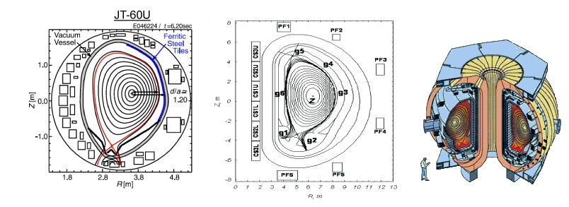
Introduction - Motivation
A tokamak fusion plasma will need to be shaped
Fusion plasma heat load too high for material limiter
Exhaust redirected to diverter protects instruments, VV wall
Shaping allows access to higher β regimes, easier access to H-Mode
All present and planned advanced tokamaks are non-circular
Notes:
Shaping has been shown or predicted to reduce severity of many plasma instabilities (ELMs, ITG, Sawteeth)

Slide 5
Introduction - Motivation
A tokamak fusion plasma will need to be shaped
HBT-EP’s Mission (in part):
To quantify external kink dynamics and multimode response to applied magnetic perturbations… in ways that are ITER and reactor relevant^{[1]}
Kink instabilities potentially limit performance in fusion reactors
HBT-EP is well instrumented to measure external kink modes
High resolution magnetic sensors
Passive stabilization and active control through flexible configuration
Shaping HBT-EP’s plasmas increases relevancy of kink studies to fusion reactors
¹HBT-EP Narrative, FY 2011-2013

Slide 6
Introduction – HBT-EP Capabilities
High resolution magnetic sensors
216 total sensors, in 3 arrays, measure radial and poloidal field
Highly modular passively stabilizing shells
2 independently positionable sets of 10 stainless steel/SS+ferritic walls
Active control coils
2 coils per shell (of 6) can be independently driven for RMP or feedback

Slide 7
Introduction – HBT-EP Capabilities
Zero net turns
Center bundle of 4 turns (co-I_{p}) flanked by 2 bundles of 2 (contra-I_{p})
All bundles connected in series
low self/mutual inductance
Low power supply requirements
Max current: 7.5 kA / turn
Center bundle current: 2*I_{p}
Arbitrary current/polarity
Allows variety of shapes
Fast startup, sustained current
τ_{start} < 1ms
τ_{peak} > 7ms –> I_{peak} > .9 * max( I_{max} )
Notes:
Peak defined as I_{sh} greater than 90% peak I_{sh}

Slide 8
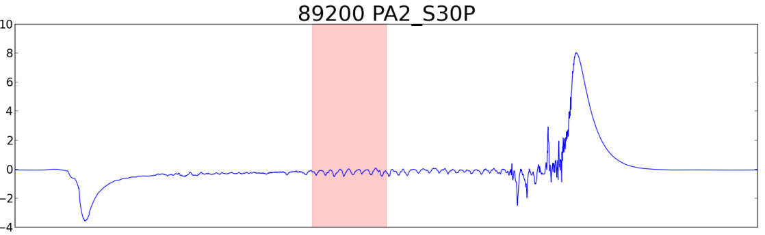
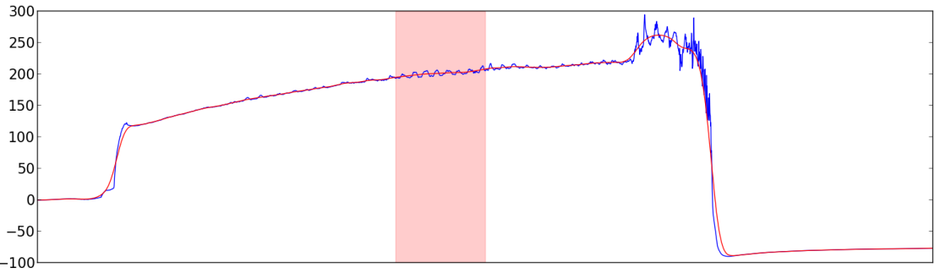
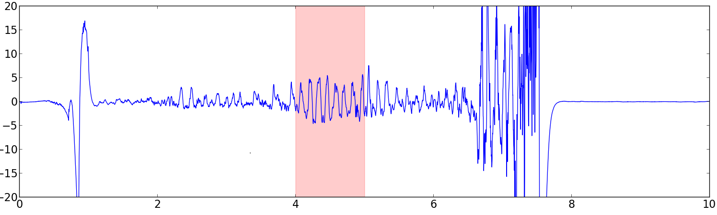
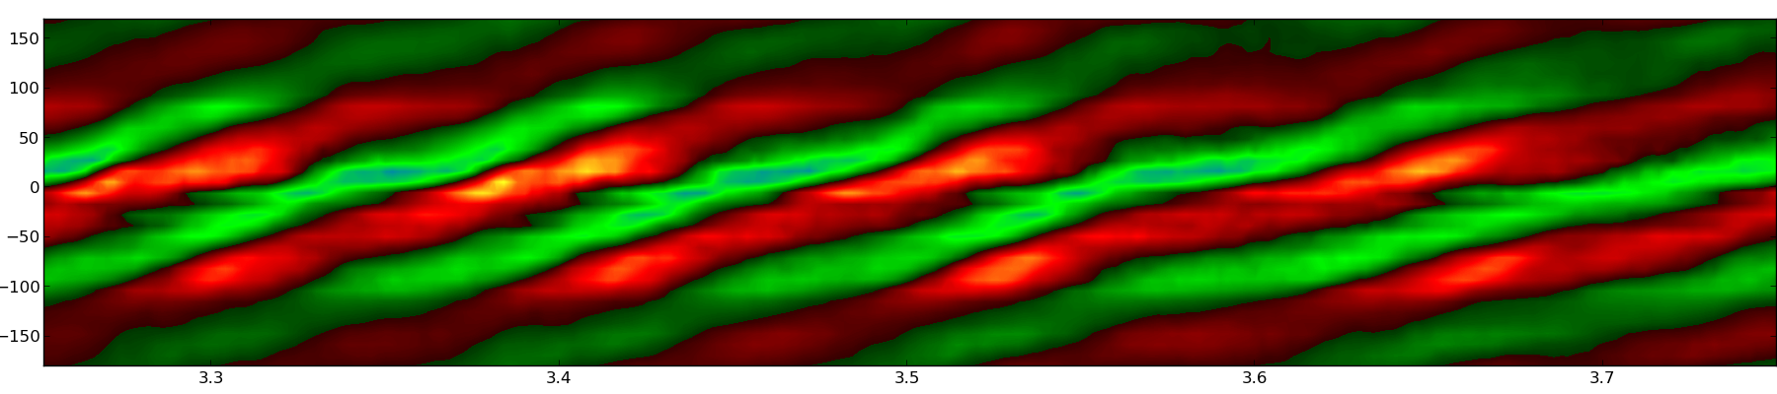
Introduction – Data Acquisition
Sensors record partially integrated signal
Integrated signal in software
Smooth equilibrium fit to data
Fluctuations separated from signal by subtracting equilibrium
Fluctuations arranged and contour plotted
Dominant mode & frequency often visible by inspection

Slide 9
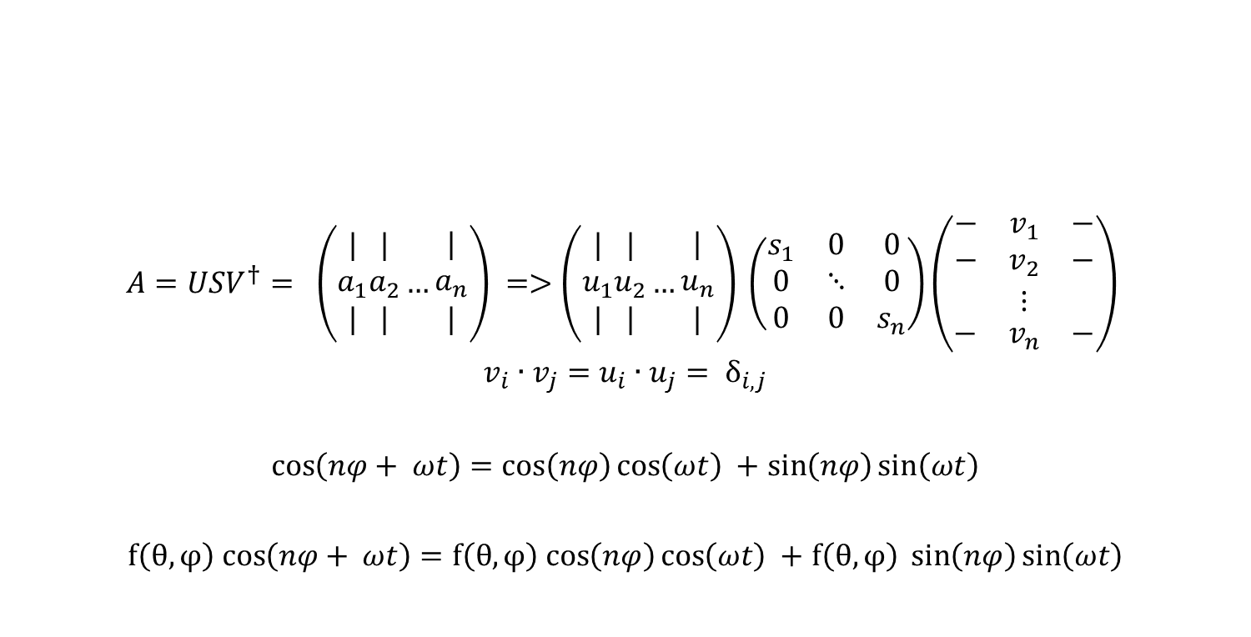
Biorthogonal Decomposition (BD)
BD resolves coherent modes from fluctuations
Mathematically equivalent to singular value decomposition
Coherent traveling modes isolated from fluctuations as degenerate pairs
Modes further broken into temporal and spatial components
Requires no a priori assumption of mode basis
Insensitive to errors in sensor positioning or orientation
$A=USV^{†}= \left(\begin{matrix}| \\ a_{1} \\ |\end{matrix}\begin{matrix}| \\ a_{2} \\ |\end{matrix}…\begin{matrix}| \\ a_{n} \\ |\end{matrix}\right) =>\left(\begin{matrix}| \\ u_{1} \\ |\end{matrix}\begin{matrix}| \\ u_{2} \\ |\end{matrix}…\begin{matrix}| \\ u_{n} \\ |\end{matrix}\right) \left(\begin{matrix}s_{1} & 0 & 0 \\ 0 & ⋱ & 0 \\ 0 & 0 & s_{n}\end{matrix}\right)\left(\begin{aligned}\begin{matrix}− & v_{1} & −\end{matrix} \\ \begin{matrix}− & v_{2} & −\end{matrix} \\ ⋮ \\ \begin{matrix}− & v_{n} & −\end{matrix}\end{aligned}\right)$
$${v_{i}∙v_{j}=u}_{i}∙u_{j}= δ_{i,j}$$
$\cos\left(nφ+ ωt\right)=\cos\left(nφ\right)\cos\left(ωt\right) +$ $\sin\left(nφ\right)\sin\left(ωt\right)$
$f\left(θ,φ\right) cos\left(nφ+ ωt\right)=f\left(θ,φ\right) cos\left(nφ\right)\cos\left(ωt\right) +$ $f\left(θ,φ\right) \sin\left(nφ\right)\sin\left(ωt\right)$

Slide 10
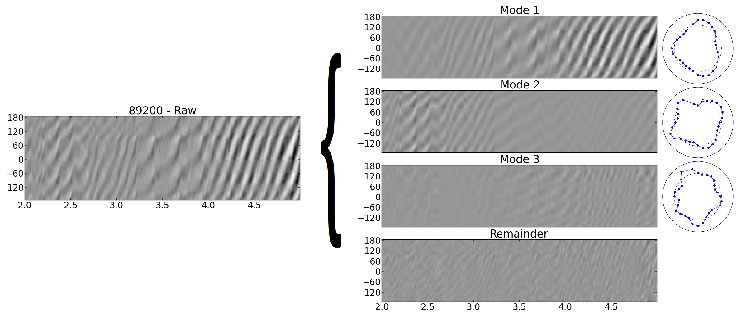
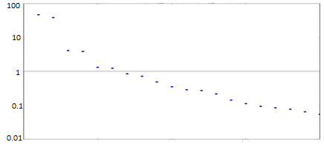
Introduction – Analysis Procedures Biorthogonal Decomposition
BD resolves coherent modes from fluctuations
Requires no a priori assumption of mode basis
Allows discrimination of modes with
power ~1% of total fluctuations

Slide 11
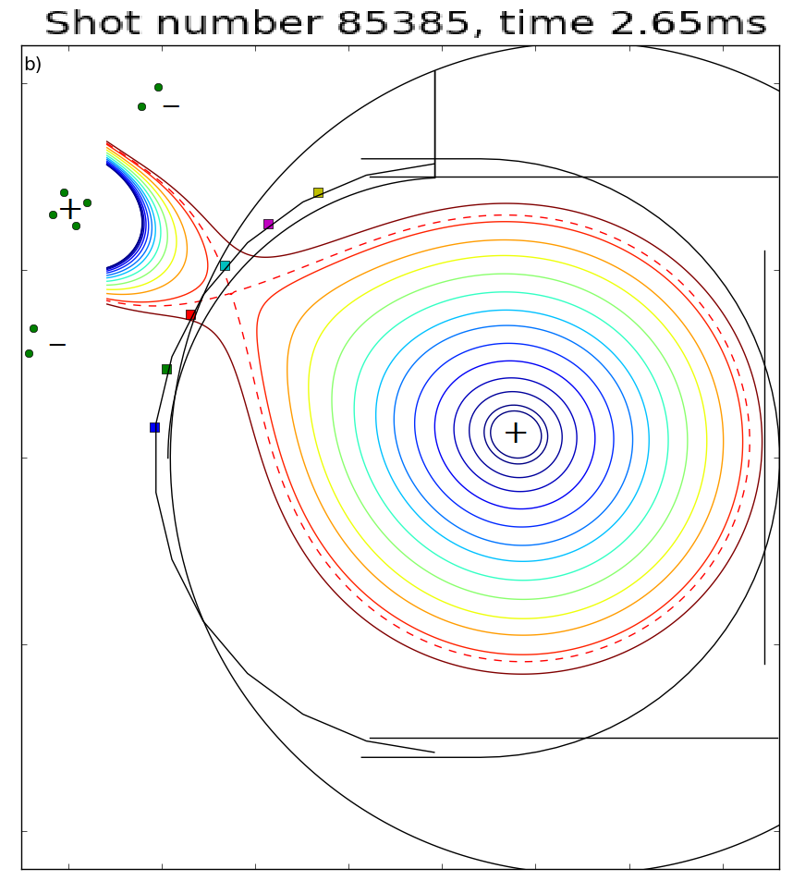
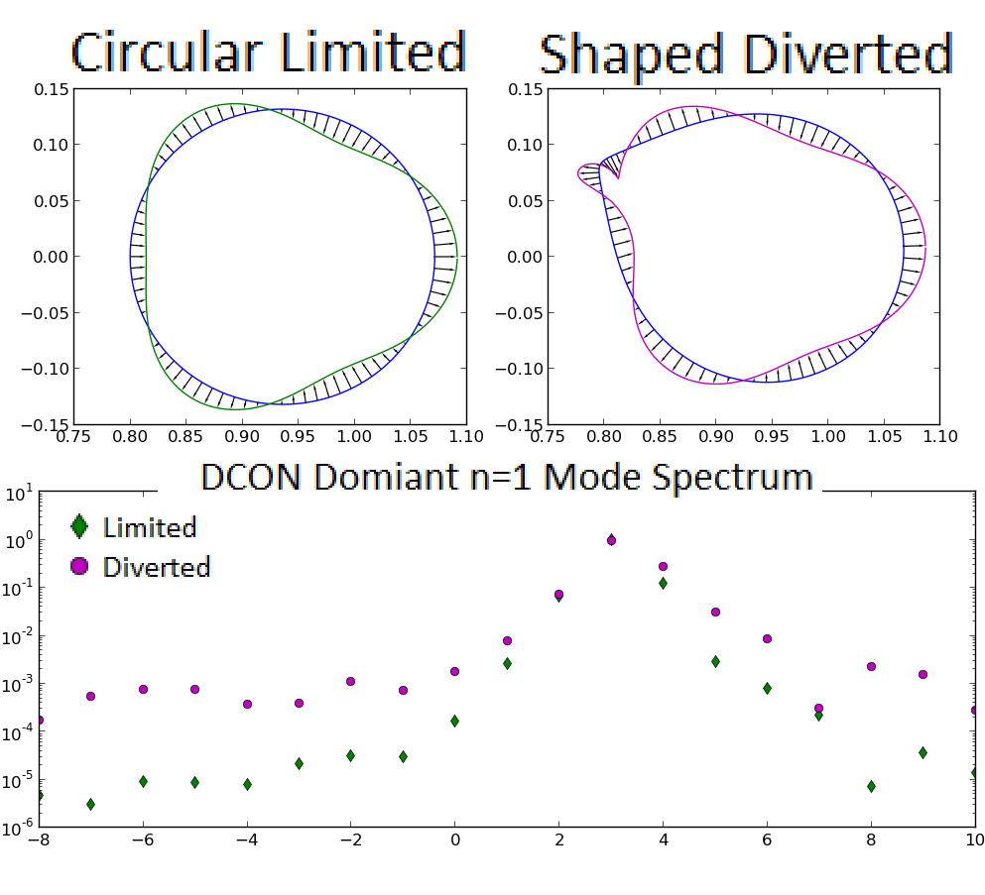
Introduction – Analysis Procedures
Equilibrium Reconstruction: TokaMac
Inputs:
Direct measurements
Empircally determined constraints
Mode Energetics and Shape: DCON
Inputs:
TokaMac Equilibrium

Slide 12
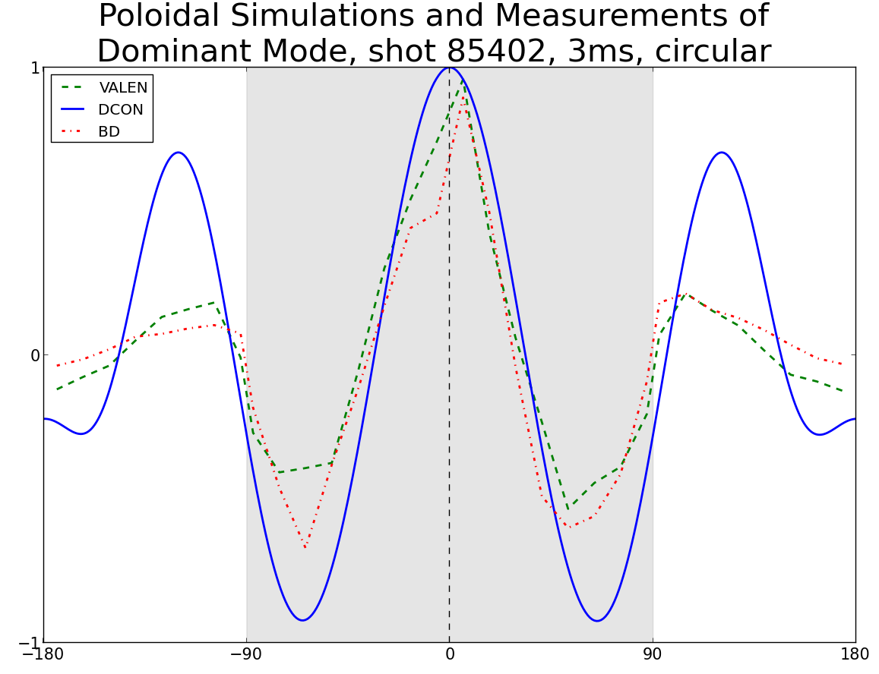
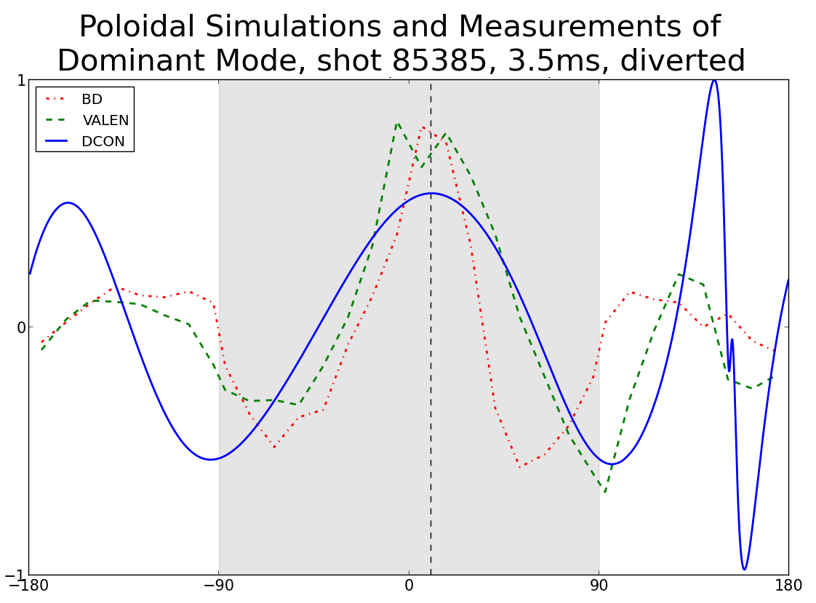
Introduction – Analysis Procedures
Mode Measurements: BD (previously discussed)
Experiment/Simulation Connection: VALEN
Inputs:
DCON modes, mode rotation speed
HBT-EP conducting structures, sensor location/orientation

Slide 13
Introduction – Analysis
Data Acquisition
Post Processing
Theory
Biorthogonal Decomposition
Fourier analysis
TokaMac
Coherent modes
m/n amplitude vs. time
DCON
Comparison of Shaped/Circular
Modes
VALEN

Slide 14
Outline
Introduction
Motivation for Shaped Plasma Research on HBT-EP
HBT-EP Baseline and New Capabilities
Analysis Procedures
New Challenges with Shaped Plasmas
Plasma/Sensor coupling
Positional Instability
Proposed Research Plan
Observe Structure and Dynamics of RWM in Shaped Plasmas
Natural Structure/Growth Rates
RMP Response
Initial Results
Summary

Slide 15
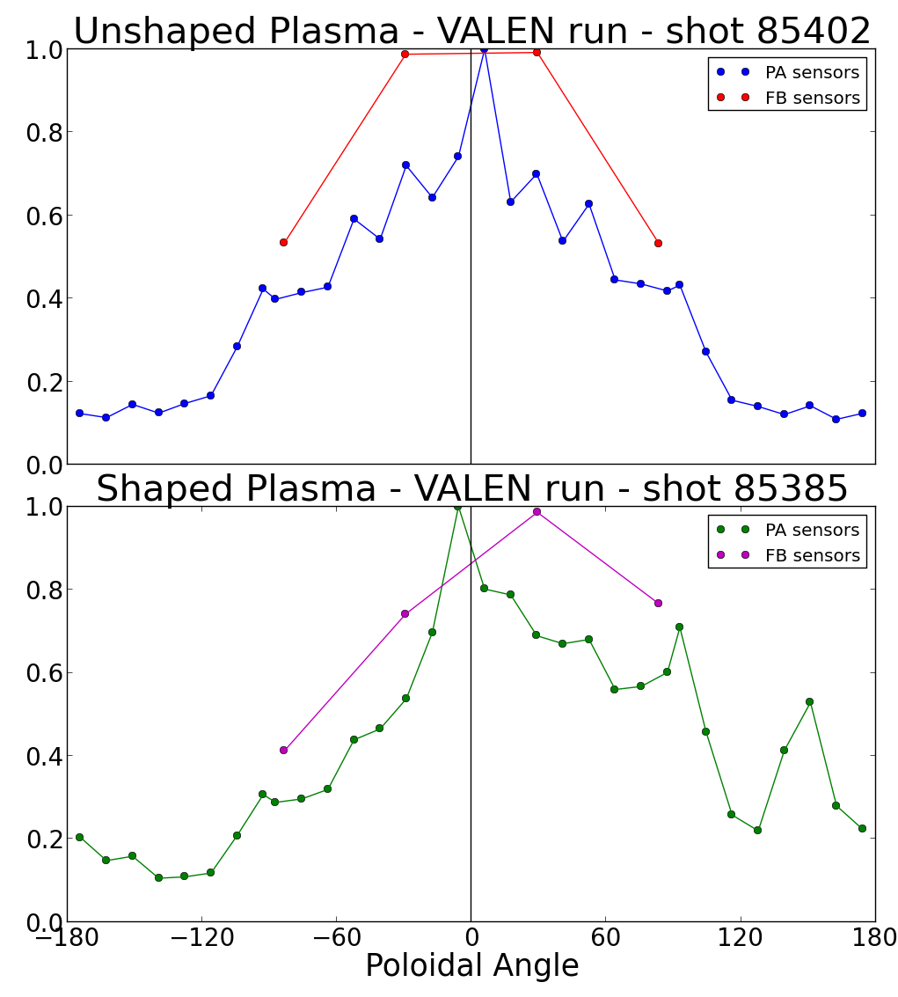
New Challenges – Plasma Sensor Coupling
Sensor arrays, control coils designed for centered, circular plasma
Coupling to shaped
plasma/mode will vary poloidally
VALEN can be used to predict coupling at each sensor/coil
More accurate measurement of plasma modes
Resonant field vs control coil current maximized
Novel method, can be applied to circular plasmas as well

Slide 16
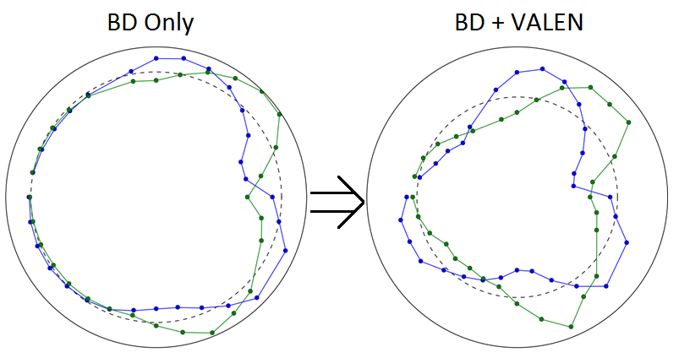
New Challenges – Plasma Sensor Coupling
VALEN can be used to predict coupling at each sensor/coil
More accurate measurement of plasma modes
Requires accurate equilibrium reconstruction
Want repeatable plasma to limit number of reconstructions

Slide 17
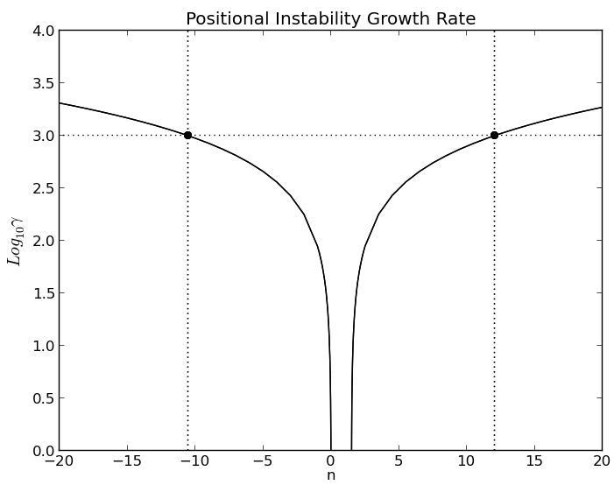
New Challenges
Vacuum fields designed for centered, circular plasma
Shaping destabilizes plasma positionally
Theory^{[2]} predicts passive stabilization of plasma position
Growth time reduced to scale longer than plasma lifetime
Shaped plasmas observed to persist for multiple ideal growth times
Shaped plasma displaced upwards
Poloidal arrays to be used
as up/down Rogowski
Algorithm under development,
will require good vacuum
field subtraction
VALEN modeling of eddies
²A. Fukuyama, Japanese Journal of App. Phys. Vol 14, No. 6 (1978), 871-877

Slide 18
Outline
Introduction
Motivation for Shaped Plasma Research on HBT-EP
HBT-EP Baseline and New Capabilities
Analysis Procedures
New Challenges with Shaped Plasmas
Plasma/Sensor coupling
Positional Instability
Proposed Research Plan
Observe Structure and Dynamics of RWM in Shaped Plasmas
Natural Structure/Growth Rates
RMP Response
Initial Results
Summary

Slide 19
Proposed Research
Explore structure and dynamics of RWMs in shaped geometry
How are the natural modes affected by shaping?
Stability, amplitude, shape, rotation frequency, disruptivity
How is the natural multimode spectrum affected by shaping?
Relative strengths of dominant/subdominant BD modes
Generally n = 1 vs n = 2
How effective is passive stabilization on a shaped plasma?
How does a shaped plasma respond to RMPs?
Changes to RFA/disruptivity?
Changes to resonant helicity?
Coupling to sidebands?

Slide 20
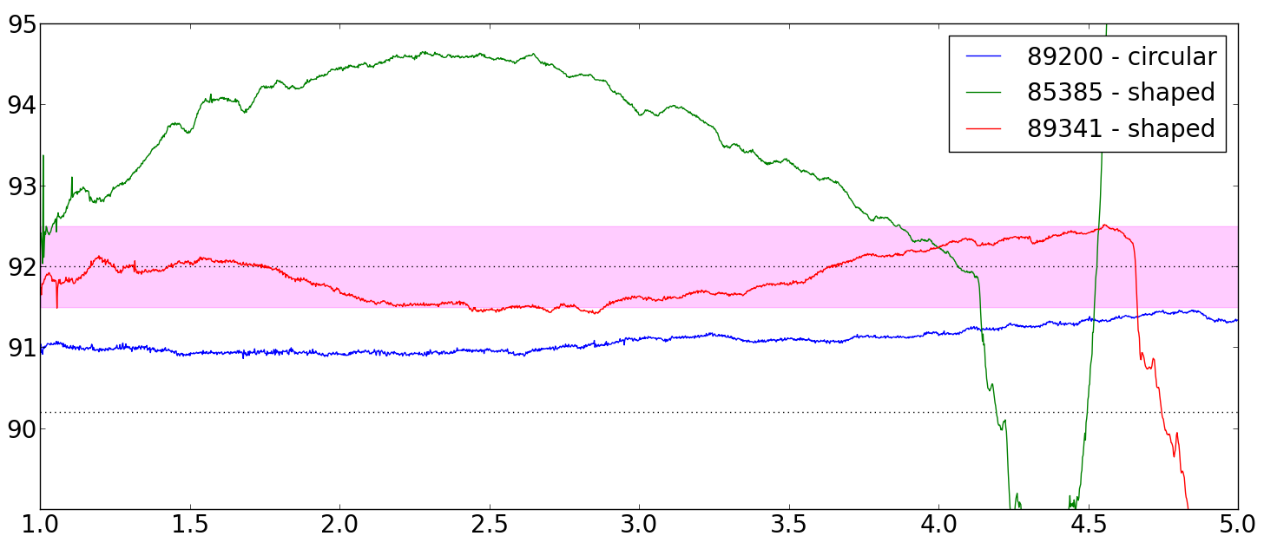
Proposed Research – Shot Development
Ensuring diversion requires deliberate equilibrium development
I_{p}, MR, VF, OH, and SH affect equilibrium and shaping degree
MR strongly affected by all other values
Location of plasma in chamber has implications for mode measurements
Want to develop diverted, centered, MR-steady plasma
Diverted: represents a break from previous limited operation
Centered: strongest possible coupling to all sensors/control coils
MR-steady: allows use of BD across long time windows
Outboard: ease of diversion
Well centered: good coupling
MR-steady: v_{plasma} < .5cm/ms

Slide 21
Proposed Research – Natural Modes
Grow database of shots w/ static, diverted, well coupled equilibrium
Observe modes
As measured by sensors & segregated by BD/Fourier analysis
As predicted by TokaMac/DCON
Compare modes
Computationally: Through DCON
Experimentally: Through sensors & BD/Fourier
Naïve – Direct comparison
VALEN – Eliminates effects of boundary shape and position
Look at shape, amplitude, q_{edge}, growth rates
Dominant mode
Subdominant mode(s)
Correlation between modes

Slide 22
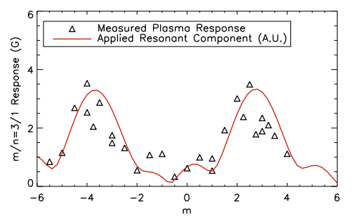
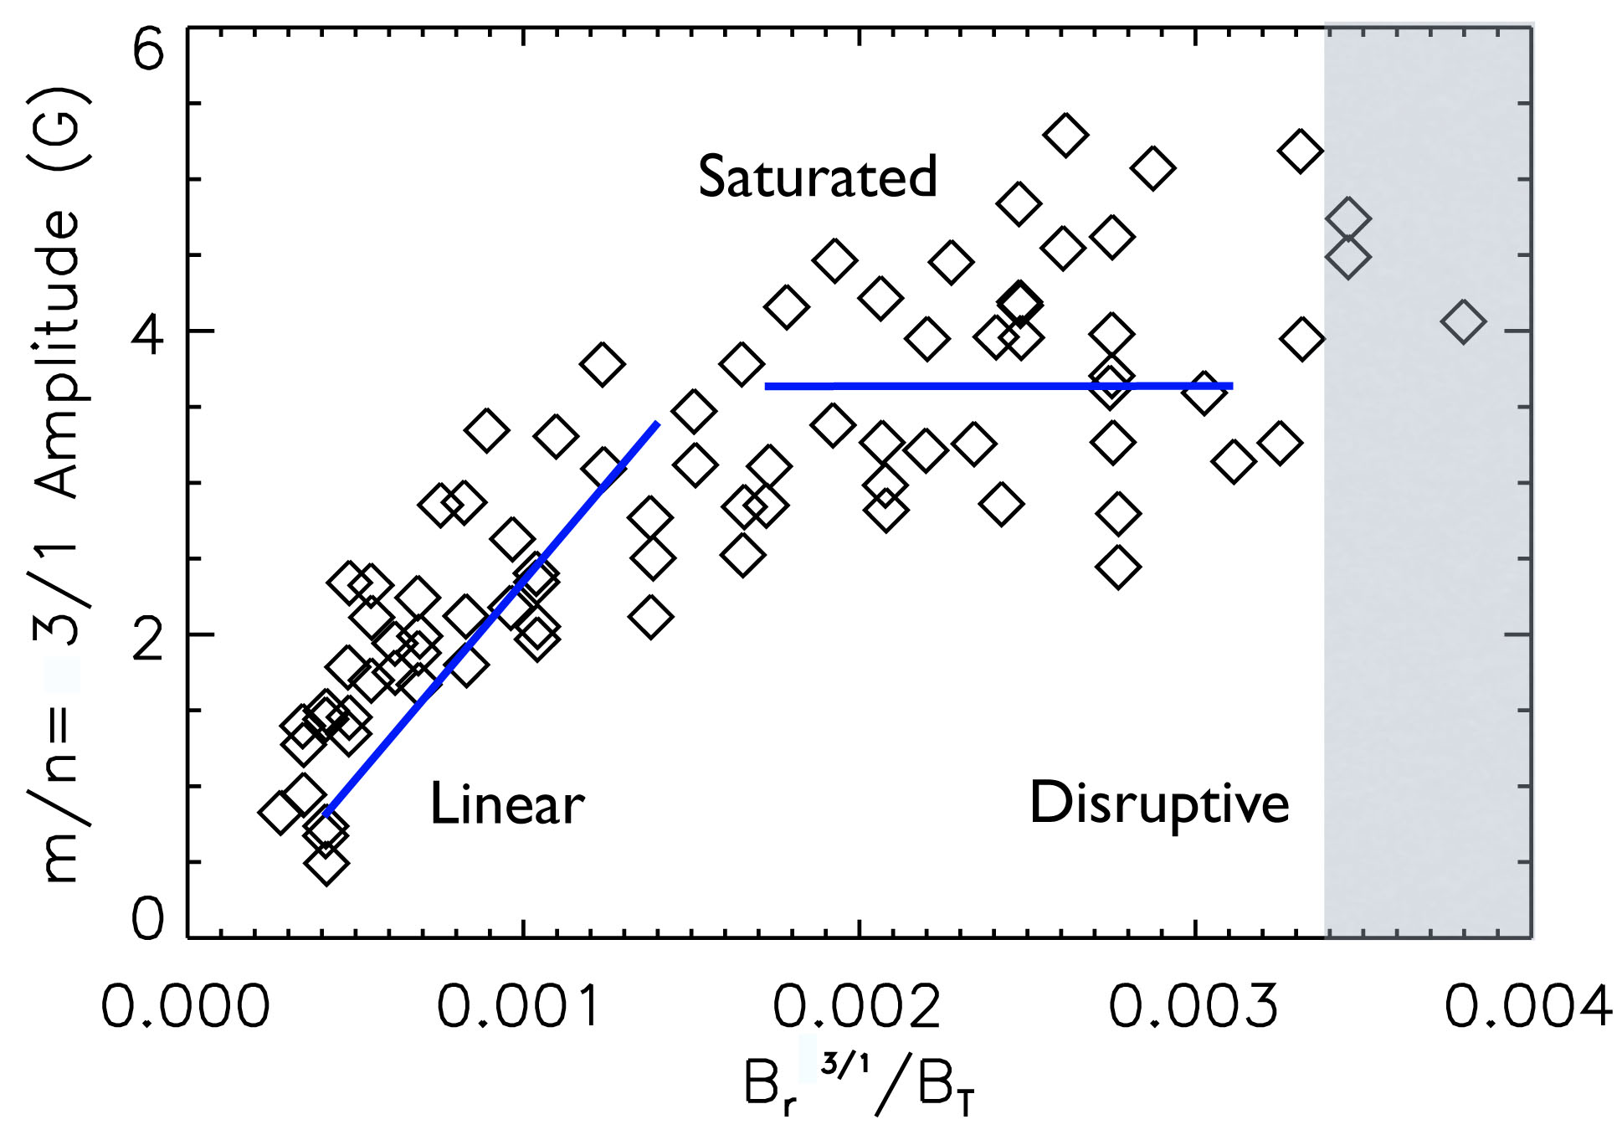
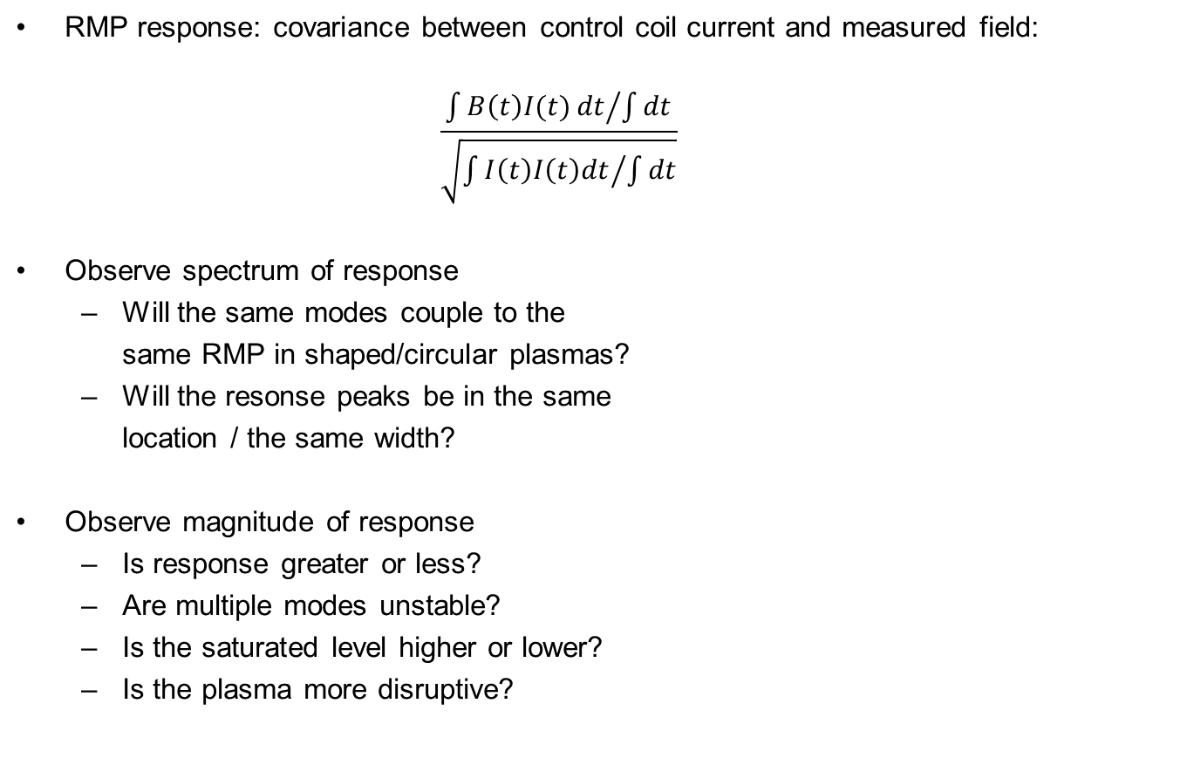
Proposed Research - RMPs
RMP response: covariance between control coil current and measured field:
$$\frac{{\int{B\left(t\right)I(t)}dt}/{\int{dt}}}{\sqrt{{\int{I\left(t\right)I\left(t\right)dt}}/{\int{dt}}}}$$
Observe spectrum of response
Will the same modes couple to the
same RMP in shaped/circular plasmas?
Will the resonse peaks be in the same
location / the same width?
Observe magnitude of response
Is response greater or less?
Are multiple modes unstable?
Is the saturated level higher or lower?
Is the plasma more disruptive?

Slide 23
Proposed Research – Workflow/Timeline
Select Pickup Subtraction Algorithm
Model Equilibria w/ TokaMac
Develop repeatable, MR-steady,
diverted & circular equilibria (x3)
2 weeks
~1.5 weeks/equilibrium (5 total)
Complete Mirnov Rogowski program
Pronounced mode activity
Low mode activity
Model modes w/ DCON
1 week
Shells out
Shells in
Project modes to sensors with VALEN
Observe Natural Modes
Excite modes using RMP
1 week/equil.
1 week/equil.
Look for effects on:
Natural Modes: Mode Shape, Saturated Amplitude, Growth rates
Driven Modes: Mode Response, Disruptivity, Resonant Helicity/bandwidth

Slide 24
Outline
Introduction
Motivation for Shaped Plasma Research on HBT-EP
HBT-EP Baseline and New Capabilities
Analysis Procedures
New Challenges with Shaped Plasmas
Plasma/Sensor coupling
Positional Instability
Proposed Research Plan
Observe structure and dynamics of RWM in shaped Plasmas
Natural structure/growth rates
RMP Response
Initial Results
Summary

Slide 25
Initial Results
Shaping Coil has been constructed and installed on HBT-EP
Allows investigation of a wide array of shaped configurations
Diverted operation has been demonstrated for first time in HBT-EP (Shot 85385)
Shot development in process
Well centered, MR-steady, high I_{sh} shots under development (Shot 89341)

Slide 26
Initial Results
VALEN has successfully been used to connect sensor measurements to B_{n} at plasma surface
Discrepancy between DCON and BD reduced significantly
More work required, better equilibrium modeling and larger database

Slide 27
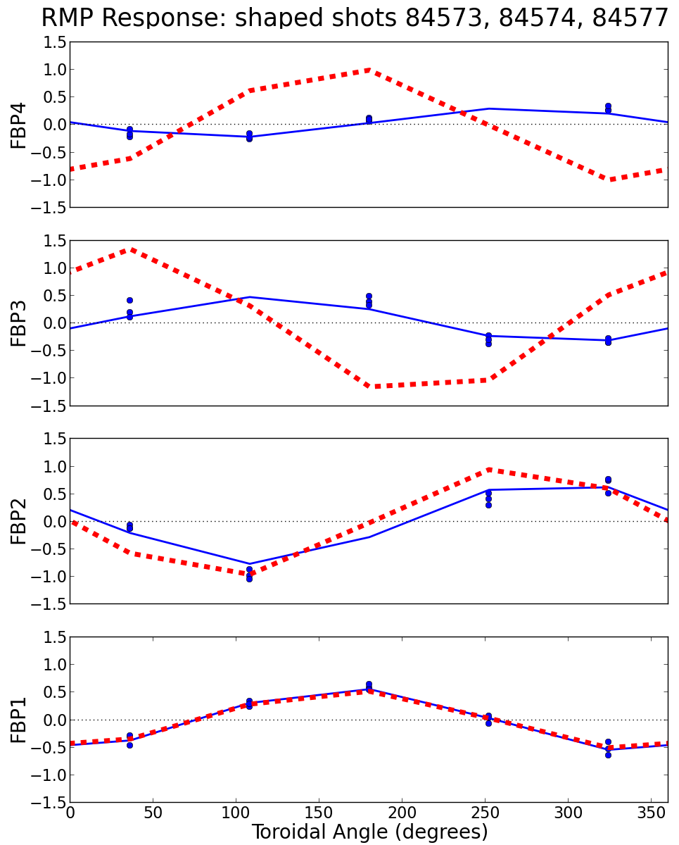
Initial Results – RMP Response
3 similar shaped shots w/
m/n = 3/1 RMP applied
Data and n=1 fit to data in blue, n/m 3/1 response in red
Poloidal variation of amplitude seen, as predicted by VALEN
Strongest coupling to RMP seen at upper midplane
Predicted to be strongest at lower midplane
Significant phase shift seen
Suggests poloidal spectrum not just than pure m=3

Slide 28
Outline
Introduction
Motivation for Shaped Plasma Research on HBT-EP
HBT-EP Baseline and New Capabilities
Analysis Procedures
New Challenges with Shaped Plasmas
Plasma/Sensor coupling
Positional Instability
Proposed Research Plan
Observe Structure and Dynamics of RWM in Shaped Plasmas
Natural Structure/Growth Rates
RMP Response
Initial Results
Summary

Slide 29
Summary
This thesis will investigate:
A novel method for projecting the output of MHD codes to predictions of direct measurements using VALEN
The structure of resistive wall modes as the plasma boundary is shaped in various ways, including full diversion
The growth rate and disruptivity of these modes as compared to circular plasmas
The effect of passive stabilization on shaped plasma RWMs
The response of shaped plasma RWMs to RMPs

Slide 30
Introduction – Analysis procedures
Plasma equilibria solved for using TokaMac
Equilibria ideal stability modeled in DCON (edge = Ψ_{99.5})
Sensor pickup forward modeled using VALEN
Actual measurements decomposed to coherent modes via biorthogonal decomposition

